Slide 1
AMAZON SALES DATA ANALYSIS USING PYTHON
BY Prachi Yuvraj Khartade

Slide 2
AGENDA
Abstract
Proposed work
Insights and Data Analysis
Conclusion

Slide 3
ABSTRACT
Objective: The analysis focuses on understanding Amazon's sales performance by exploring sales data, identifying key trends, and deriving actionable insights.
Methodology: Data was collected, cleaned, and analyzed using Python libraries such as Pandas, NumPy, Matplotlib, and Seaborn.
Key Insights: The study reveals critical patterns in sales distribution, growth trends, and correlations with other factors like pricing and marketing spend.
Outcome: The insights gained provide a foundation for strategic decision-making to enhance sales and optimize performance.

Slide 4
PROPOSED WORK
Data Collection and Cleaning: Gather Amazon's sales data and checked for missing values, duplicates, and ensuring data consistency.
Exploratory Data Analysis (EDA): Perform EDA to understand the distribution of sales, identify trends, and detect outliers.
Correlation and Trend Analysis: Analyze the relationships between sales metrics and external factors to uncover significant correlations and trends.
Visualization and Insights: Develop visualizations to represent key findings and provide actionable insights to support strategic decision-making.

Slide 5

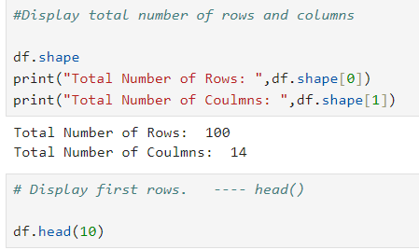





PROPOSED WORK
RAW DATA ANALYSIS AND CLEANING:
Firstly uploaded the dataset and analysed it.
Searched for missing values.

Slide 6
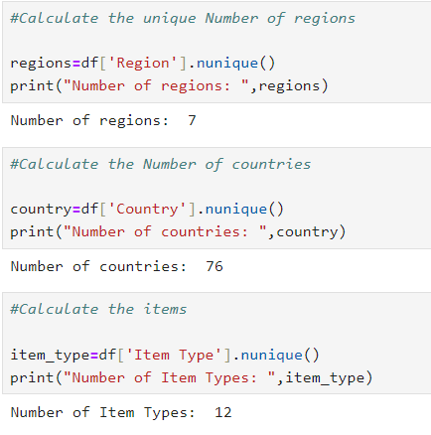
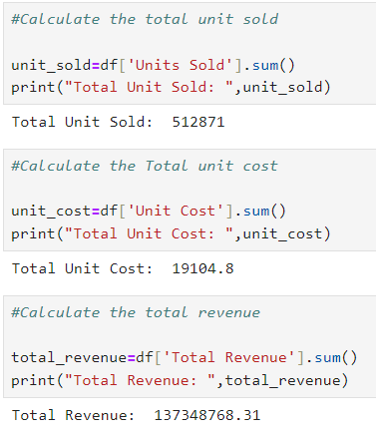
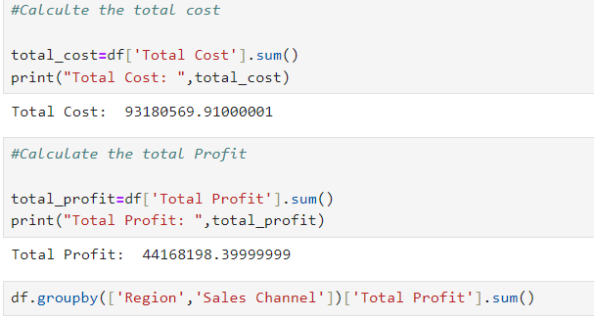
PROPOSED WORK
Exploratory Data Analysis (EDA):
Sales Distribution: Analyzed the distribution of sales data across different time periods..
Sales Trends: Identified trends over time, such as seasonal spikes and dips..
Outlier Analysis: Investigated outliers to understand anomalies in sales performance.

Slide 7
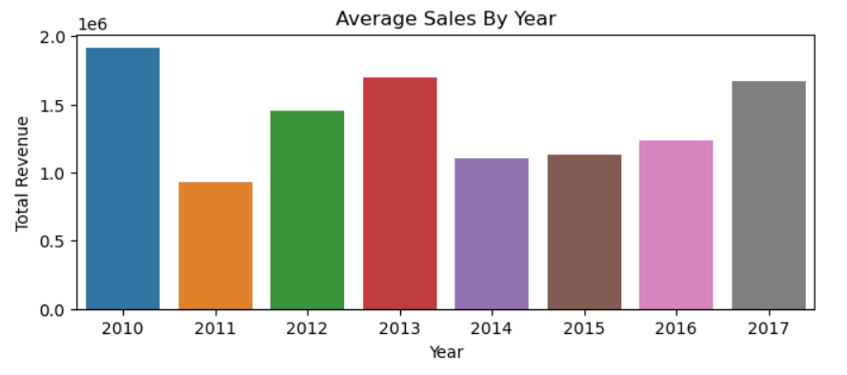
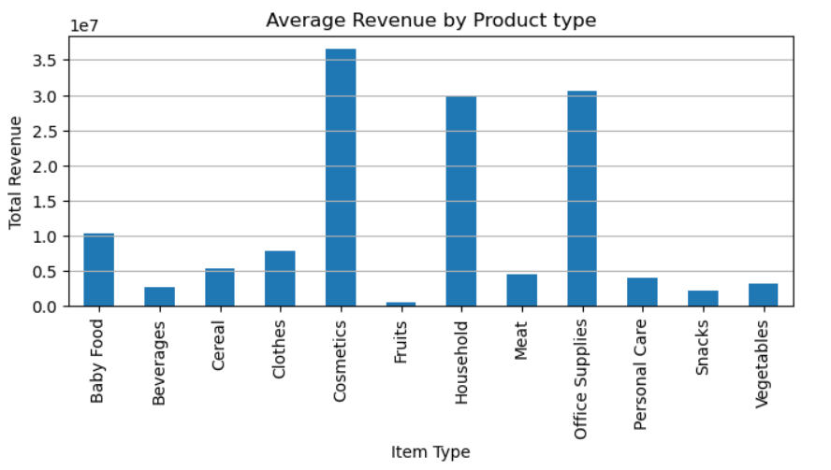
VISUALIZING DATA
Bar graph represents Year wise sales
Bar chart for Average revenue by Product type

Slide 8
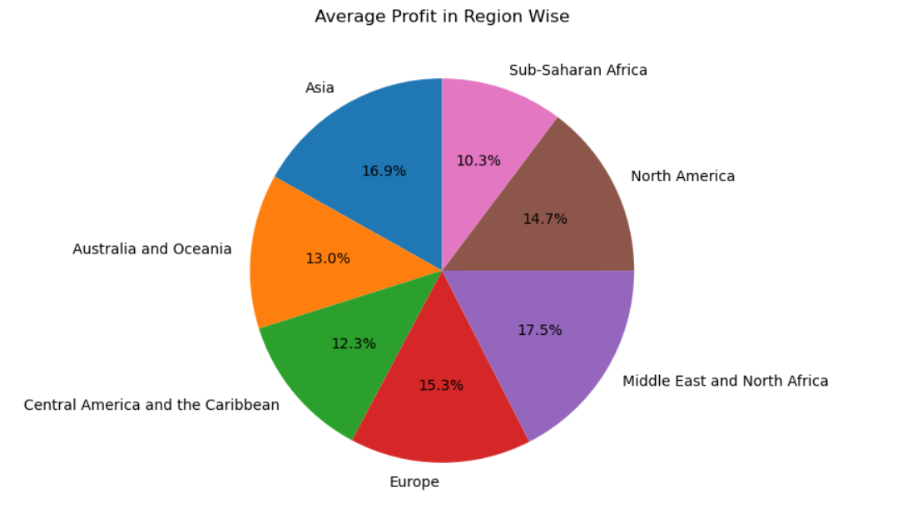
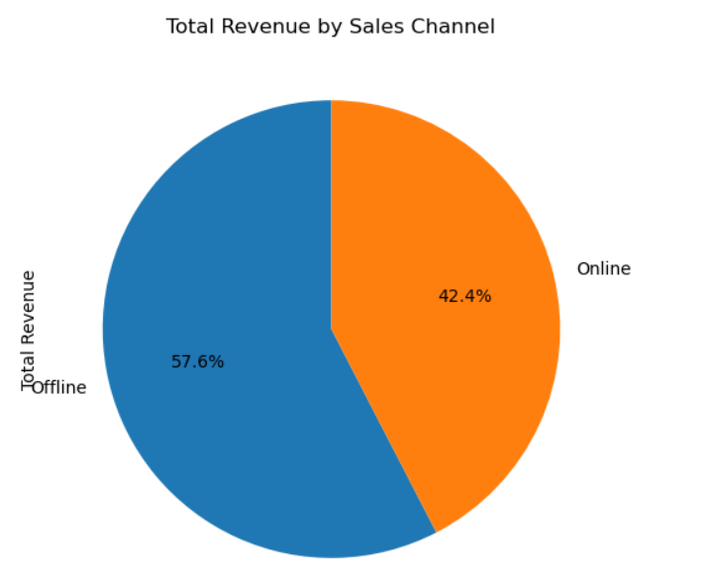
VISUALIZING DATA
Pie chart represents Average Profit in region wise
Bar chart for Total revenue by Sales Channel

Slide 9
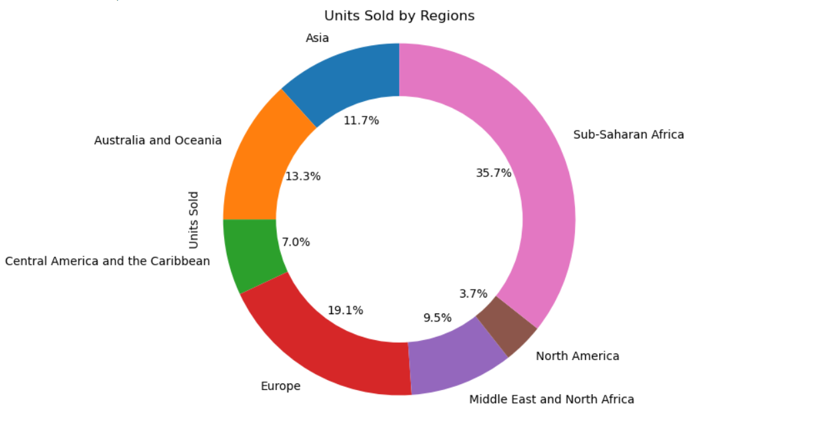
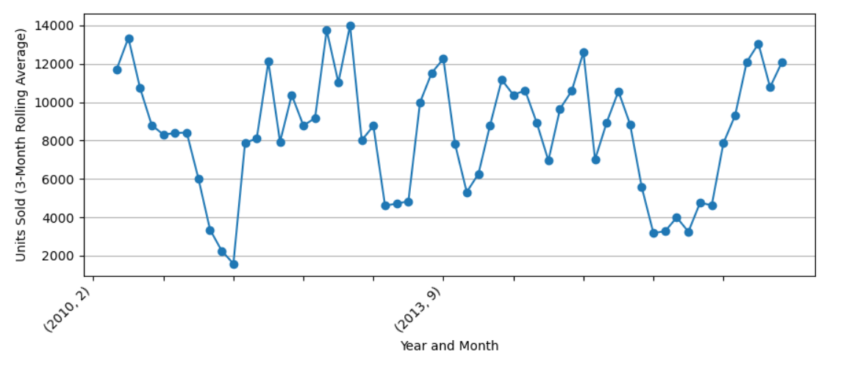
VISUALIZING DATA
Create a donut chart for Units Sold Region wise.
Bar chart to represent grouped units sold by year and month

Slide 10
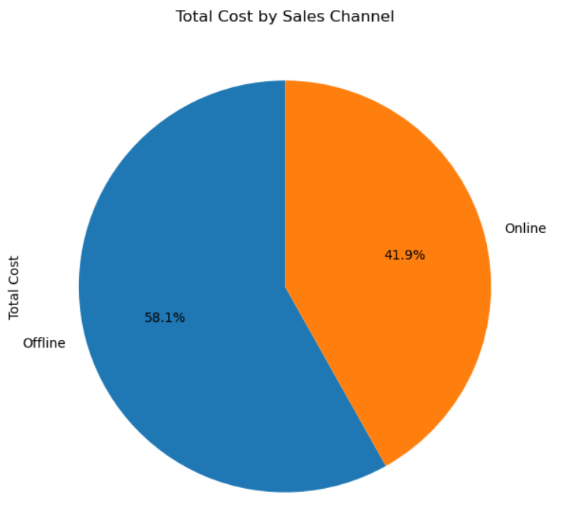
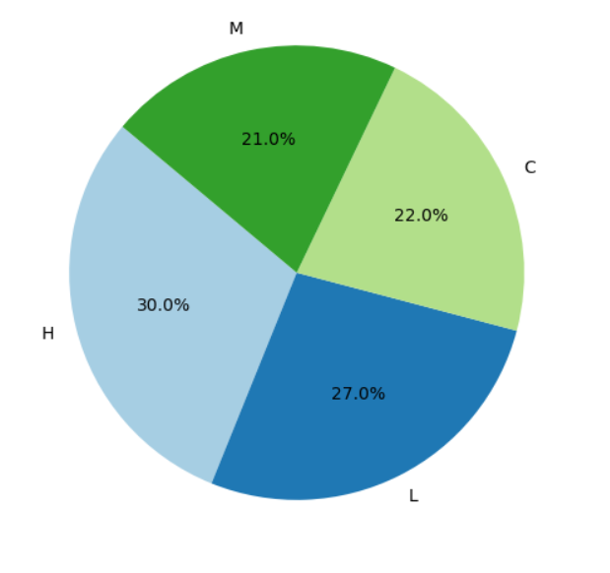
VISUALIZING DATA
Used pie chart to display grouped total cost by sales channel.
Pie chart to represent Order Priority distribution.

Slide 11
INSIGHTS AND DATA ANALYSIS
Europe leads in total profit, driven by strong online sales, while other regions like Asia and Sub-Saharan Africa excel more in offline sales.
The average sales show significant fluctuations over the years, with 2010 and 2013 experiencing the highest total revenue. After a decline in 2011, there was a notable recovery in 2012 and 2013.
The data suggests that 2017 marked a rebound in sales, potentially setting the stage for future growth, similar to the peak years of 2010 and 2013.
Beverages and Meat generate the highest average revenue among the listed product types.
Fruits and Vegetables contribute significantly less to total revenue.
Offline Sales contribute to a larger share of total revenue (57.6%).
Online sales constitute a smaller portion of total revenue (42.4%).

Slide 12
INSIGHTS AND DATA ANALYSIS
The Middle East and North Africa region contributes the highest average profit among the listed regions(17.5%).
Europe follows closely with a profit share of 15.3%.
Sub-Saharan Africa has the lowest average profit share at 10.3%.
Sub-Saharan Africa accounts for the highest percentage of units sold among these regions (35.7%).
Asia follows with a unit share of 13.3%.
Australia and Oceania have a smaller share at 3.5%.

Slide 13
CONCLUSION
The analysis focuses on understanding Amazon's sales performance by exploring sales data, identifying key trends, and deriving actionable insights.
Certain product categories consistently outperformed others in terms of revenue and profit margins. Additionally, top-performing products showed consistent sales growth, while underperforming products exhibited declining trends. This information could be crucial for inventory management and product development strategies.
The insights gained provide a foundation for strategic decision-making to enhance sales and optimize performance
This process also contributed to the development of advanced data analysis and visualization skills using Python, further equipping us for future challenges.

Slide 14
THANK YOU
By Prachi Khartade

